Slide 1
Mentorship Program
How to Develop & Maintain a Successful
Academy of Business
Clairemont High School, 2014
Liz Rush
All documents referred to in this presentation can be found at www.AcademyCHS.org under Mentorships.

Slide 2
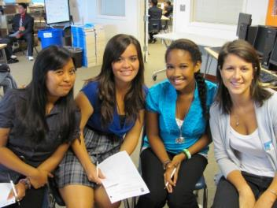
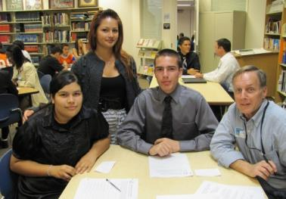
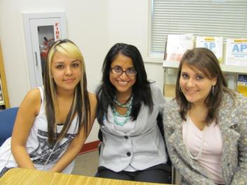
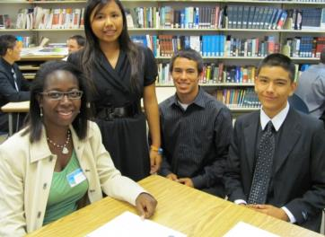
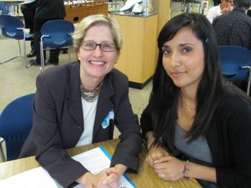
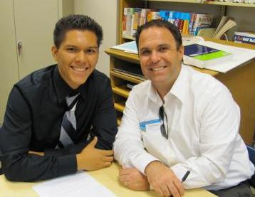
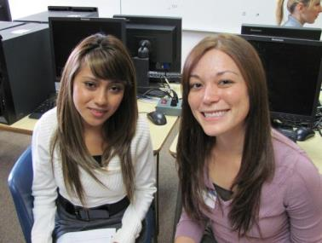
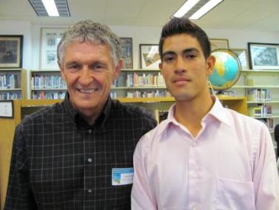
Our AOB Mentoring Program
* 70 mentors this year
5th Year of Mentor Program
All Sophomores and Juniors participate
One-Year Commitment
Changed EVERYTHING!

Slide 3
“None of us has gotten where we are solely by pulling ourselves up from our bootstraps. We got here because somebody...bent down and helped us.”
-Thurgood Marshall

Slide 4
Steps to Build Your Mentor Program
Step 1:
Recruitment
Step 2:
Orientations & Matching
Step 3:
Meetings & Follow Up
Step 4: Communication & Reflection

Slide 5
1. Recruitment
Organize & Advertise
Find Mentors
Register Mentors

Slide 6
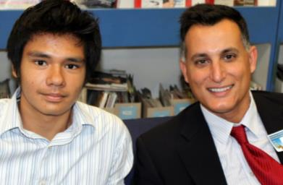
Identify student areas of weakness
Project number of mentors needed
Build time into the school day
Create a website with all program info
Plan meeting agendas & dates in advance
Schedule a Master Calendar, book location
Compile a Mentor Handbook
1a. Recruitment:
Organize & Advertise
Back to Recruitment

Slide 7
Back
Back

Slide 8
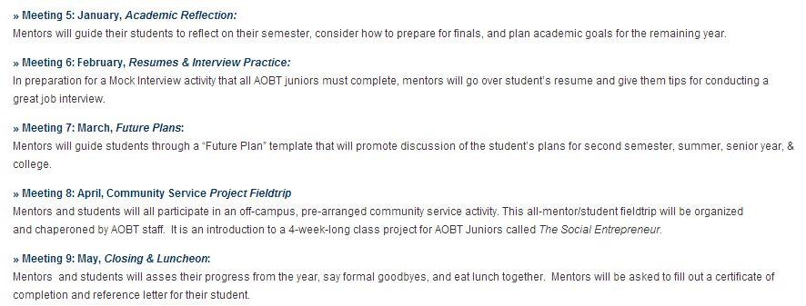
Back

Slide 9
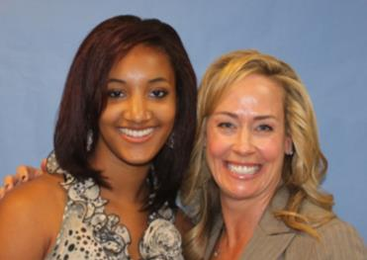
Start in the summer!
Beg, borrow & steal!
Lean on your Advisory Board
Use your staff’s personal contacts
Tap anyone who has volunteered before
Advertise in local paper
Partner with one or two large companies
1b. Recruitment:
Find Mentors
Back to Recruitment

Slide 10
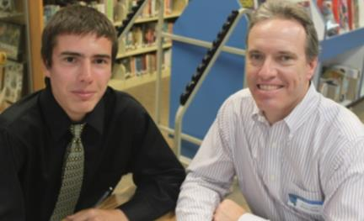
Sign up volunteers on online form
Try a Google Form!
Require Fingerprint/Background Check
Hold a mandatory Mentor Orientation
Obtain mentor paperwork:
Mentor Contract
Vehicle & DL Information
1c. Recruitment:
Register Mentors
Back to Recruitment

Slide 11
Back

Slide 13
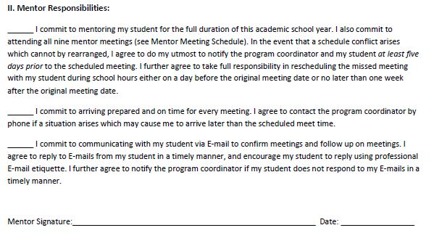
Back

Slide 14
2. Matching & Orientation
Profile
Pair or Group
Orient

Slide 15
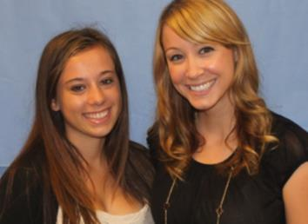
Use mentor registration to profile
Give students & mentors similar profiles
Ask extensive personality questions
Use a Google Form!
Sample Mentor Profile
Sample Student Profile
2a. Matching & Orientation:
Profile
Back to Matching & Orientation

Slide 16
Mentor Profile Questions
1. Name
2. Gender
3. Ethnicity
4. Company/ Organization
5. Address
6. Work Phone
7. Mobile Phone
8. Work E-mail Address
9. Home E-mail Address
10. Fax Number
11. Preferred Contact
12. Career/ Industry
13. Job Duties
14. Past Work
15. Education
16. Community Involvement
17. Foreign Languages
18. Who referred you?
19. Which Program?
20. Schedule Flexibility
21. Conviction Disclosure
22. Mentor Orientation
22. Fingerprinting
23. Mentor Orientation
24. Motivation to Mentor
Experience with You
26. Personality Traits
27. Beliefs
28. Interests & Hobbies
29. Music Preferences
30. Sports/ Athletics
31. Movie/ TV
32. Favorite Holiday(s)
33. Travel Interests
34. School Subjects
35. Other Info
36. Match Preferences
37. Unique Fact
Back

Slide 17
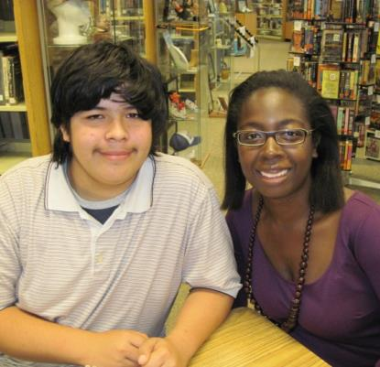
Most important: match personalities
Use teachers and advisory
Ask for mentor preferences
Ask for student preferences
Human machine
Don’t underestimate the importance of a good match
2b. Matching & Orientation:
Pair & Group
Back to Matching & Orientation

Slide 18
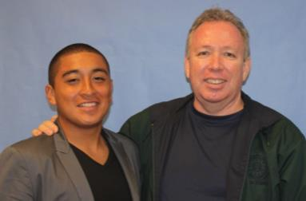
Mentor Orientation:
Give background on academy & students
Have return mentors share & introduce students!
Give training in dealing with teens
Outline meetings, give out handbook, sign forms
Student Orientation:
Give background on mentors & professions
Have return students who participated last year share
Give training in manners, good communication, etc.
Outline meetings, give out student handbook, sign parent forms
2c. Matching & Orientation:
Orientations
Back to Matching & Orientation

Slide 19
3. Meetings
Intro
Face-to-Face
E-mail

Slide 20
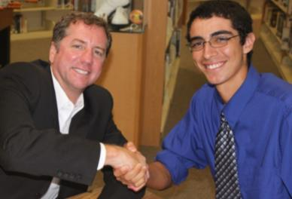
Make it a big deal!
Dress to Impress!
Keep matches a secret until day of
Do an ice breaker to find each other
Students introduce mentors
First activity should build trust & self esteem
3a. Meetings
Introduction
Back to Meetings

Slide 21
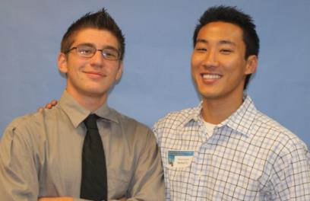
Once per month at least
Location on site
One or two hours
Supervised by teacher(s)
Structured agendas
One-to-one or group mentoring
Which mentor program?
3b. Meetings
Face-to-Face

Slide 22
Which Mentor Program?
10TH GRADE
11TH GRADE
Group mentoring, 3:1
Sophomore students
Focus on skills for success, good habits, academics
Group dynamic at meetings
Some meetings longer
Correspond with 3 students
Students younger, more impressionable
Experience with youth helpful
One-on-one mentoring
Junior students
Focus on goals, future, career-exploration & training
Personal dynamic at meetings
Job Shadow & Community service fieldtrips
Correspond more often with student
Student more mature, but more set in ways

Slide 23
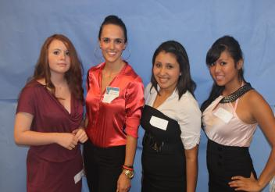
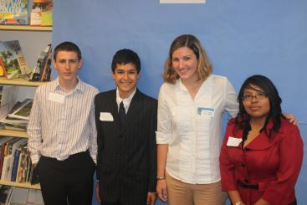
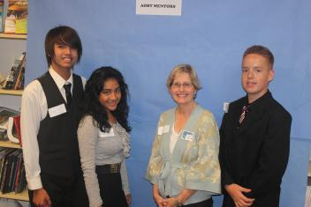
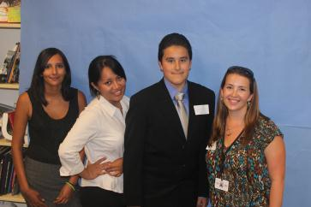
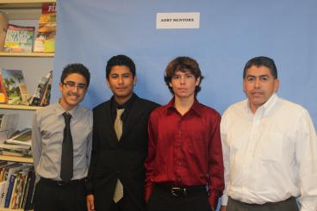
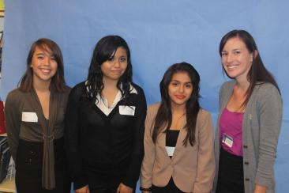
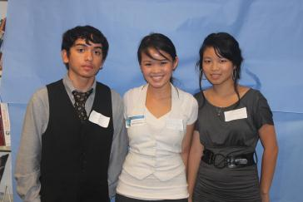
AOBT 10th Grade Mentor Program
*Group Mentoring, 3:1
*Focus on Motivation

Slide 24
Scheduled Meetings – 10th Grade Program
MONTH | MEETING TOPIC | SCHEDULED DATE /TIME
Sept. | Mentor-Student Group Meeting 1: Introductions & Ice Breakers | Thur, Sept. 27, 2012 1:00 – 2:15 pm
Oct. | Mentor-Student Group Meeting 2: Team Building, Goal Setting & Individual Check-Ins* | Thur, Oct. 18, 2012 1:00 – 3:00pm*
Nov. | Mentor-Student Group Meeting 3: Educational Group Fieldtrip Day | Choose a day between: Mon. Nov. 5 – Thur. Nov. 15
Dec. | Mentor-Student Group Meeting 4: A Good Habit: Time Management | Thurs, Dec. 20, 2012 1:00 – 2:15 pm
Jan. | Mentor-Student Group Meeting 5: Academic Reflection | Thur, Jan. 17, 2013 1:00 – 2:15 pm
Feb. | Mentor-Student Group Meeting 6: Career Aptitude Discussion & Check-Ins* | Thur, Feb. 21, 2013 1:00 – 3:00 pm*
Mar. | Mentor-Student Group Meeting 7: Mentor Team Building Olympics | Thur, Mar. 21, 2013 1:00 – 2:15 pm
Apr. | Mentor-Student Group Meeting 8: College Forum & Debrief | Thur, Apr. 18 1:00 – 2:15 pm
May | Mentor-Student Group Meeting 9: Affirmations, Closing & Luncheon | Thurs, May 16, 2013 1:00 – 2:15 pm
Page

Slide 25
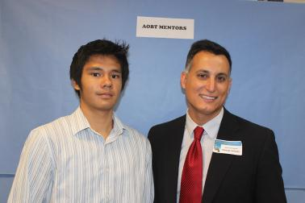
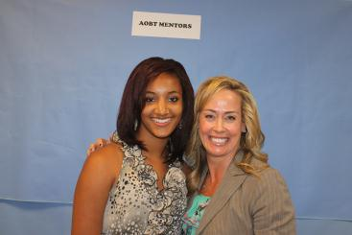
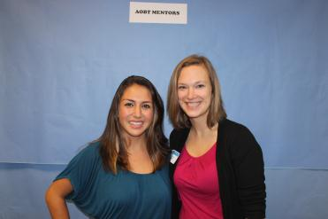
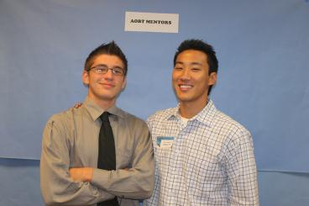
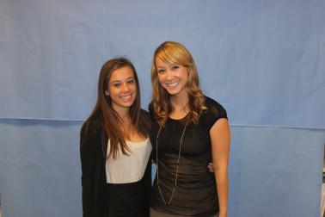
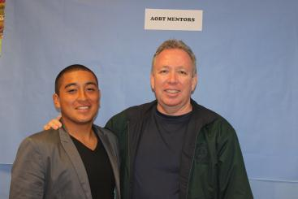
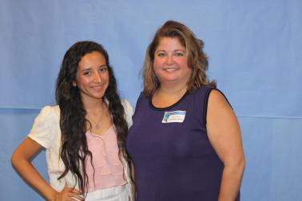
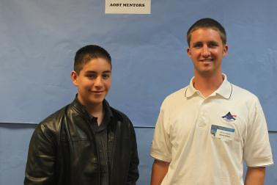
AOB 11th Grade Mentor Program
*One-on-One Mentoring
*Career Focus

Slide 26
Scheduled Meetings – 11th Grade Program
MONTH | MEETING TOPIC | SCHEDULED DATE /TIME
Sept. | Mentor-Student Meeting 1: Intro, Ice Breakers, Self-Esteem | Thursday, Sept. 27, 2012 12:00 pm – 1:15 pm
Oct. | Mentor-Student Meeting 2: Academic Goal-Setting | Thursday, Oct. 18, 2012 12:00 – 1:15 pm
Nov. | Mentor-Student Meeting 3: Job Shadow Fieldtrip Day | Choose date in window: Mon., Nov.5 – Th. Nov. 15
Dec. | Mentor-Student Meeting 4: Mentor Roadmap Interviews | Thursday, Dec. 20, 2012 12:00 – 1:15 pm
Jan. | Mentor-Student Meeting 5: Academic Reflection | Thursday, Jan. 17, 2013 12:00 – 1:15 pm
Feb. | Mentor-Student Meeting 6: Resume & Interview Techniques | Thursday, Feb. 21, 2013 12:00 – 1:15 pm
Mar. | Mentor-Student Meeting 7: Future Plans | Thursday, Mar. 21, 2013 12:00 – 1:15 pm
Apr. | Mentor-Student Meeting 8: Community Service Project Trip | Friday, Apr. 26, 2013 Exact times TBA
May | Mentor-Student Meeting 9: Final Closing & Luncheon | Thursday, May 16 12:00 – 1:15 pm
Back to Meetings

Slide 27
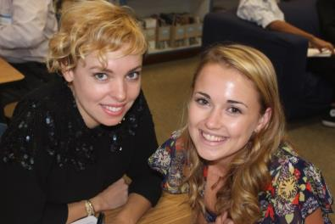
Maintains continuity between meetings
Teaches professional e-mail etiquette
Use e-mail scripts to start
Confirm meetings
Send updates, grades, thank yous
Set up additional activities
3c. Meetings
E-mail
Back to Meetings

Slide 28
4. Communication & Reflection
Reminders
Check-ins & debriefs
Recognition & Survey

Slide 29
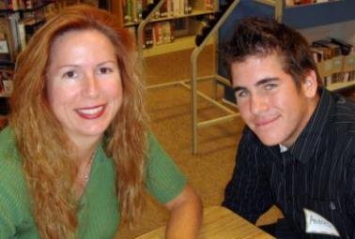
Need a program coordinator
Electronic calendar invites
Coordinator e-mails agenda reminders
Students confirm meetings
Alternate meetings
Mentor Contact Sheet for networking
4a. Communication & Reflection
Reminders
Back to Communication & Refection

Slide 30
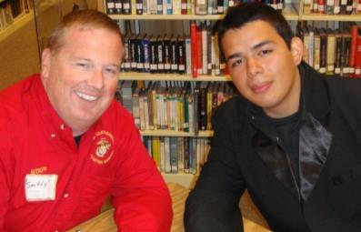
For Mentors:
Coordinator asks for feedback monthly
Return emails & calls!
For Students:
Sharing after meetings
Journals & Reflections
Follow up thank you emails
Present to classmates about mentor
4b. Communication & Reflection
Check-ins & Debriefs
Back to Communication & Refection

Slide 31
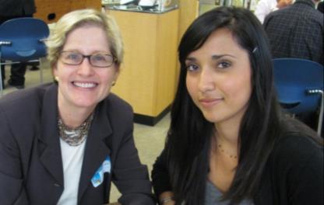
Mentors get award & take survey at end
Recommend changes
Indicate interest for next year
Board members review
Students get award & take survey at end
What they learned from program
Rate mentor
4c. Communication & Reflection
Recognition & Survey
Back to Communication & Refection

Slide 33
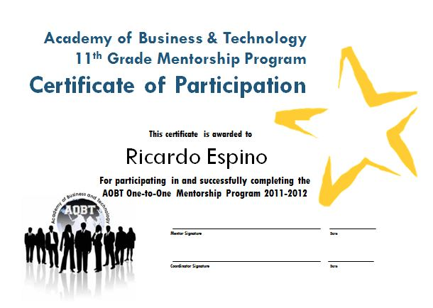

Slide 34
Thank you! Questions?
Liz Rush, AOBT Coordinator
www.aobt.net
erush@sandi.net
858-204-9363

Slide 35
AOBT Mentorship Program
Academy of Business & Technology
Mentor Orientation
Clairemont High School, 2011

Slide 36
Welcome & Introductions
Academy of Business & Technology
Mentor Orientation
Clairemont High School, 2011

Slide 37
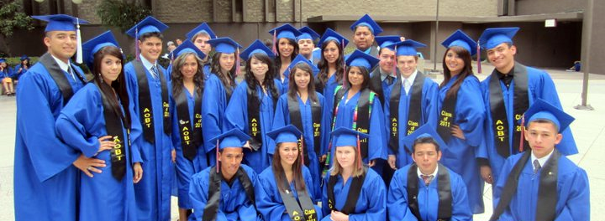
About AOBT Students
Small learning community
10-12 Grade
Business industry focus
Family environment
College & career prep
Community involvement
“At-Risk”

Slide 38
Student Speakers
Gustavo Ponce
Athena Genshaw
Ian Gayola

Slide 39
Contact & Communication
Program Coordinator: Liz Rush
erush@aobt.org
858-204-9363
(email and text preferred)
E-mail Mentor Lists
E-Calendar Invites for meetings
www.aobt.org
Mentor Handbooks

Slide 40
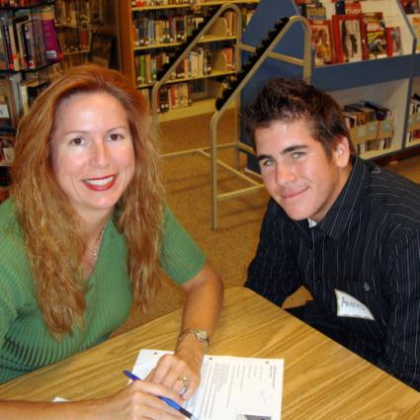
I. Objectives of Mentor Program
Role Models for our students
Build self-esteem & motivation
Career preparation
Community connections
Page 5

Slide 41
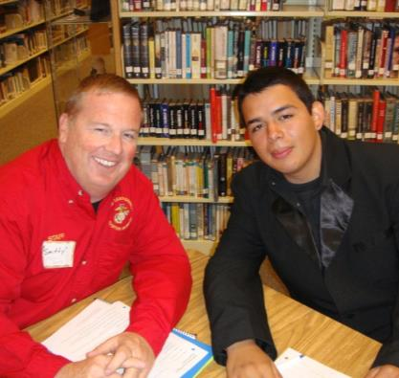
II. Defining the Mentor Experience
What is a mentor?
Benefits to mentees
Benefits to mentors
Who should be a mentor?
Responsibilities of a mentor
Pages 6-7

Slide 42
Commitment: You should have no problem committing to mentor if:
You can easily prioritize the monthly Thursday-morning mentor meeting without conflicts.
You can make a commitment to be on time at every single scheduled meeting.
Follow-through is one of your strengths; you can go above and beyond the required meetings.
You have the dedication and patience to help your student open up in conversation.
You will be available to communicate regularly with your mentee (once per week) via e-mail.
You are able to see the program through to completion.
Page

Slide 43
Commitment: You should think twice before committing to mentor if:
You are in the process of switching careers.
You foresee a major life change this year that will restrict your time (wedding, baby, lengthy vacation, etc.)
You plan to move out of San Diego in the next 9 months.
Your work requires you to travel unexpectedly for long periods of time.
Your schedule is very unpredictable and/or inflexible.
You can already see a conflict with two or more of the scheduled meeting days/times.
Page

Slide 44
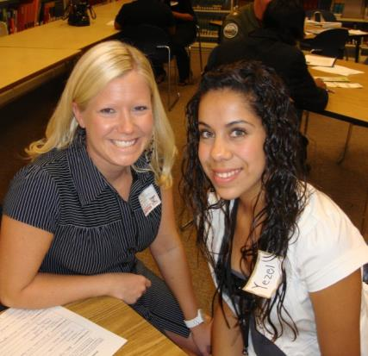
III. Effective Mentoring Relationships
Understand reluctance to trust
Mentoring = giving
Reassurance & Support
Problem-solving
Connect today and tomorrow
Capitalize on mentee interests
Don’t get too personal
Be “shock proof”
Realistic expectations
Page 8

Slide 45
IV. Relationship Developmental Process
Stage 1: Building Trust
Stage 2: Reaching Goals & Getting Comfortable
Stage 3: Completing Mentorship
Pages 9-10

Slide 46
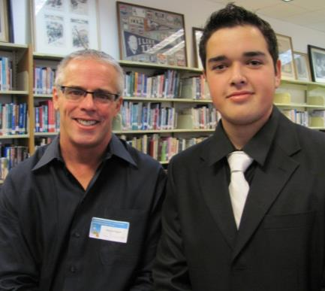
V. Helpful Mentor
Guidelines & Tips
Leading Scheduled Meetings
Dealing with Communication Barriers
Mentoring through e-mail
Optional mentor-student activities
Pages 11-12

Slide 47
Which Mentor Program?
10TH GRADE
11TH GRADE
Group mentoring, 3:1
Sophomore students
Focus on skills for success, good habits, academics
Group dynamic at meetings
Some meetings longer
Correspond with 3 students
Students younger, more impressionable
Experience with youth helpful
One-on-one mentoring
Junior students
Focus on goals, future, career-exploration & training
Personal dynamic at meetings
Additional observation day
Correspond more often with student
Student more mature, but more set in ways

Slide 48
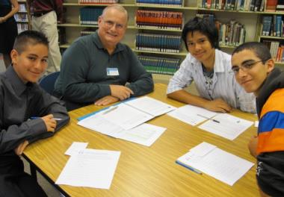
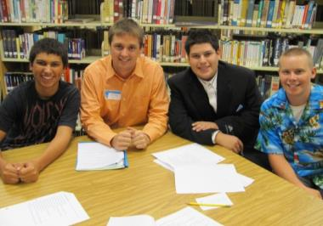
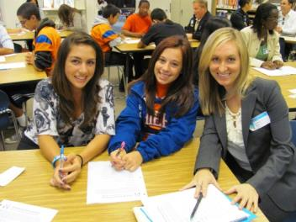
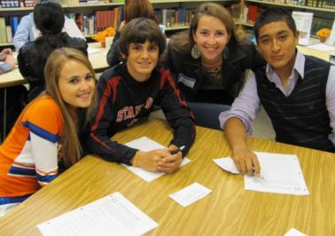
AOBT 10th Grade Mentor Program
*Group Mentoring, 3:1
*Focused on Motivation

Slide 49
Scheduled Meetings – 10th Grade Program
MONTH | MEETING TOPIC | SCHEDULED DATE /TIME | LOCATION
Sept. | Mentor-Student Meeting 1: Intro: Meet Mentors, Ice Breakers | Thursday, Sept. 29 12:00 – 1:15 pm | Clairemont High Library
Oct. | Mentor-Student Meeting 2: Team-building, Goals & Check-Ins | Thursday, Oct. 20 12:00 – 2:00 pm | Clairemont High Library
Nov. | Mentor-Student Meeting 3: Developing Time Management | Thursday, Nov. 17 12:00 – 1:15 pm | Clairemont High Library
Dec. | Mentors’ Holiday Tea Party Chat No students present | Thursday, Dec. 15 11:30 am – 12:15 pm *Before meeting | Clairemont High
Dec. | Mentor-Student Meeting 4: Team-Building Activities | Thursday, Dec. 15 12:15 – 1:15 pm | Clairemont High Library
Jan. | Mentor-Student Meeting 5: Academic Reflections | Thursday, Jan. 19 12:00 – 1:15 pm | Clairemont High Library
Feb. | Mentor-Student Meeting 6: Educational Group Fieldtrip Day | Choose a date within: Mon., 2/6 – Thur. 2/16 | TBD by mentor & students
Mar. | Mentor-Student Meeting 7: Career Aptitude & Check-Ins | Thursday, Mar.15 12:00 – 2:00 pm | Clairemont High Library
Apr. | Mentor-Student Meeting 8: College Forum & Debrief | Thursday, Apr. 19 12:00 – 1:15 pm | Clairemont High Library
May | Mentor-Student Meeting 9: Final Closing & Banquet | Thursday, May 17 12:00 – 1:15 pm | Clairemont High Library
Page

Slide 50
10th Grade Mentoring
Meeting 1: Introductions
Match Up Activity
Two-Minute Introductions
Meet Your Mentor
Things We Have In Common
September
Page
Pages 16-17

Slide 51
10th Grade Mentoring
Meeting 2: Success, Goal-Setting & Check-Ins
October
Ice Breaker: How’s the Weather
Secrets of Success
Attributes For Improvement
Goal-Setting Tips & Academic Goals
One-on-One Check-Ins with each student individually (longer meeting)
Page
Pages 18-26

Slide 52
10th Grade Mentoring
Meeting 3: Time Management
Ice Breaker: My Pictures
How Do I Spend My Time? Activity
Backward Planning Activity
November
Page
Pages 27-30

Slide 53
10th Grade Mentoring
Mentors’ Holiday Tea Party Chat
Before mentor-student group meeting
Bring finger foods to share
All mentors and teachers present
No students
Discuss, debrief, and problem-solve as a group
December
Page 31

Slide 54
10th Grade Mentoring
Meeting 4:
Team-Building Activities
Fun team-building games
Mentor-student groups competing
Directed by staff
Dress comfortably
Not strenuous!
December
Page
Page 32

Slide 55
10th Grade Mentoring
Meeting 5:
Academic Reflection
January
Ice-Breaker: Skittles Conversations
Catch-Up Time
Academic Reflection on Semester
Brainstorm Education Fieldtrip Day
Page
Page 33

Slide 56
10th Grade Mentoring
Meeting 6:
Educational Group Fieldtrip
Choose one day during two-week window
Choose a hands-on location
Coordinate and schedule logistics with group
Arrange transportation (Mentor Vehicle Form)
Inform coordinator of details
February
Page
Pages 34-35

Slide 57
10th Grade Mentoring
Meeting 7:
Career Aptitude & Check-Ins
March
Ice Breaker: What I Wanted to Be When I Grew Up
Discuss Holland Profile Career Suggestions
Check-Ins
Page
Pages 36-41

Slide 58
10th Grade Mentoring
Meeting 8:
College Forum & Debrief
April
College Forum: Mentors as a panel
Discussion of Post-Secondary Academics
Set up for College Quest
Page
Page 42

Slide 59
10th Grade Mentoring
Meeting 9:
Closing & Luncheon
May
Thank-you Luncheon
Assessment of Year’s Progress
Future Outlook
Closing: Goodbye & Contact Info
Mentorship Program Feedback Form
Pages 43-46

Slide 60
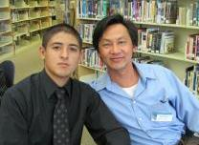
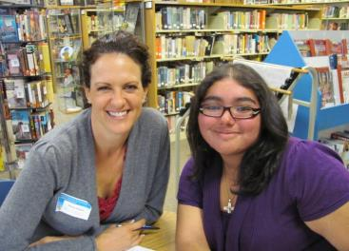
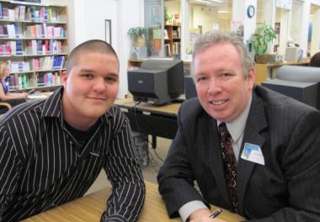
AOBT 11th Grade Mentor Program
*One-on-One Mentoring
*Career-Focused

Slide 61
Scheduled Meetings – 11th Grade Program
MONTH | MEETING TOPIC | SCHEDULED DATE /TIME | LOCATION
Sept. | Mentor-Student Meeting 1: Intro: Breaking the Ice | Thursday, Sept. 29 10:15 am – 12:00 pm | Clairemont High Library
Oct. | Mentor-Student Meeting 2: Academic Goal-Setting | Thursday, Oct. 20 10:15 – 11:30 am | Clairemont High Library
Nov. | Mentor-Student Meeting 3: Classroom Observation Day | Choose a date within: Mon, 11/14 - Fri, 11/ 18 Times TBD by mentor | Clairemont High Various classrooms
Dec. | Mentor-Student Meeting 4: Team-Building Activities | Thursday, Dec. 15 10:15 – 11:30 am | Clairemont High Lunch Quad
Dec. | Mentors’ Holiday Tea Party Chat No students present | Thursday, Dec. 15 11:30 am – 12:15 pm *Following meeting | Clairemont High Library
Jan. | Mentor-Student Meeting 5: RoadTrip Nation Interviews | Thursday, Jan. 19 10:15 – 11:30 am | Clairemont High Library
Feb. | Mentor-Student Meeting 6: Job Shadow Fieldtrip Day | Choose a date within: Mon., 2/6 – Thur. 2/16 Times TBD by mentor | TBD by mentor
Mar. | Mentor-Student Meeting 7: Resume & Interview Techniques | Thursday, Mar.15 10:15 – 11:30 am | Clairemont High Library
Apr. | Mentor-Student Meeting 8: Future Plans | Thursday, Apr. 19 10:15 – 11:30 am | Clairemont High Library
May | Mentor-Student Meeting 9: Final Closing & Banquet | Thursday, May 17 10:15 am - 12:15 am | Clairemont High Library
Page

Slide 62
11th Grade Mentoring
Meeting 1:
Intro, Self-Esteem & Goals
Mentor Presentations & Match-Up Activity
Mentor-Student Introductions
Self-Esteem Activity
Personal Goal-Setting
September
Page 16-20

Slide 63
11th Grade Mentoring
Meeting 2:
Academic Review & Goals
October
Discussion of Post-Secondary Academics
Student Academic Progress
Academic Goals For the Year
Page 21-23

Slide 64
11th Grade Mentoring
Meeting 3:
Classroom Visitation Day
November
Choose one day during week-long window
Schedule day with student
Observe student’s classes
Debrief with student or by e-mail
Page 24-26

Slide 65
11th Grade Mentoring
Meeting 4:
Team-Building Activities
Fun team-building games
Mentor-student pairs competing
Directed by staff
Dress comfortably
Not strenuous!
December
Page 27

Slide 66
11th Grade Mentoring
Mentors’ Holiday
Tea Party Chat
After mentor-student meeting
Bring finger foods to share
All mentors and teachers present
No students
Discuss, debrief, and problem-solve as a group
December
Page 28

Slide 67
11th Grade Mentoring
Meeting 5:
Roadtrip Nation
January
Catch up & Updates
Roadtrip Nation Interview
Schedule Job Shadow Day
Page 29-32

Slide 68
11th Grade Mentoring
Meeting 6:
Job Shadow Fieldtrip
Choose one day during two-week window
Mentor takes student to worksite (or alternate location)
Arrange logistics & transportation (Mentor Vehicle Form)
Student fills out Job Shadow Career Sheet
February
Page 33-36

Slide 69
11th Grade Mentoring
Meeting 7:
Resume & Interview Techniques
March
Catch-up and Updates
Review & Revise Resume
Interview Preparation & Practice
Page 37-41

Slide 70
11th Grade Mentoring
Meeting 8:
Future Planning
April
Typo in Mentor booklet on date!: Thur. Apr. 19
Update on Student Goals
Future Plans Worksheet
Letter of Reference
Page 42-45

Slide 71
11th Grade Mentoring
Meeting 9:
Closing & Luncheon
May
Assessment of Year’s Progress
Closing: Goodbye, Recognition, Future Contact
Mentorship Program Feedback
Thank-you Luncheon
Page 46-49

Slide 72
Final Steps:
AOBT Mentor Contract
School Volunteer Application
Live Scan: Request to Conduct Volunteer Screening Form
Notecard for Matching
Student Preferences (Optional)
Page

Slide 73
LiveScan Screening
OPTION 1:
To complete through the SDUSD Police Services LiveScan Department :
* Cleared prior to first mentor-student meeting on Sept 29.
* (If LiveScaned by SDUSD in last year, or employee, info should be on file.)
* Fee is $51.
* SDUSD Police Services Office in University Heights, 4100 Normal St.
* Mon – Fri, Walk-ins: 8:30 am – 1pm / Appts.: 2 - 4:00 pm
* Take proper form of ID and Request to Conduct Volunteer Screening Form. To properly fill out this form:
Check “CATEGORY D – Volunteer Fingerprint” at the top
For “REQUESTING SCHOOL” write “Clairemont High”
For “VOL. COORDINATOR,” write “Liz Rush.”
* Say from “Liz Rush’s Mentor Program at Clairemont High”
* Helen Elhard, LiveScan Supervisor: helhard@sandi.net

Slide 74
LiveScan Screening
OPTION 2:
To complete through alternate LiveScan facility:
* Cleared prior to first mentor-student meeting on Sept 29.
* Fee varies according to facility
* Take proper form of ID and Request For LiveScan Form
* Use pre-filled form
* Return completed form to SDUSD Fingerprinting Office immediately upon completion so they finish the clearance process.
* Helen Elhard, LiveScan Supervisor: helhard@sandi.net

Slide 75
Notecard:
One unique fact about yourself
-Be creative, original, specific
-Something interesting/conversation starter to break ice
-Do NOT write your name on this
-Example: I was bit by the state fish while snorkeling on the Big Island of Hawaii.
Write First and Last Name
Stick note to back of your index card
For 11th Grade Mentors Only

Slide 76
Thank You, Mentors!
It’s going to be a great year!
See you on Thursday, Sept. 29.

